Slide 1


PharmaShield
By
The Error Squad
Project Definition & Scope
Our project aims to utilize immutability and the ability to mint tokens offered by a blockchain to enforce accountability and mitigate drug flow into illicit channels.
This project is the broad-scope solution to the leak of drugs into illegal media due to flaws and under-the-table deals between players.

Slide 2
UNDERSTANDING THE PROBLEM
The players in this system are
The raw material supplier
The drug manufacturer
The distribution centers (pharmacies)
The prescribing doctor
The patient
The pharmaceutical chain of production to patient faces issues that include inaccuracy in tracing the drug leak , client-doctor confidentiality, agreement breaches and many more that mainly arise due to lack of accountability at each minor transaction stage and an unstable trust based infrastructure.

Slide 3
THE APPROACH
Our project is a DApp that has mainly two code functionalities -
Manufacturing tokens (M)
Collecting tokens (C)
A few easily implementable pre-requisites:
The manufacturer is responsible for token minting.
The raw material supplier is responsible for token collection and maintenance.
The tokens received are stored in a pool maintained by the supplier.
There is an equation in place that relates the token quantity to manufactured drug quantity.
Within the supply chain , the receiver of the drug (Logistic support like drivers , pharmacies, patients) has to validate the drug quantity he receives using the same (C) functionality.

Slide 4
Step 01: The manufacturer mints tokens in accordance with the amount of drug Y (say 50 kg), he is capable of producing. (say 50 tokens for 50 kg).
Step 02: These tokens are then sent to the supplier who collects, verifies and sends raw materials proportional to the amount of drug Y that is going to be produced (in this case raw materials for 50kgs of drug Y, hence the supplier now has 50 tokens in possession)
Step 03: This ensures that the manufacturer is only able to produce the stipulated amount of drug Y and distribute it.
Here we would like to shed light on the fact that up until now there is an accurate track of the amount of drug Y in circulation. This is because the driver confirms that he has received some amount of drug Y from the manufacturer (in this case 50kg) and as he delivers it to the pharmacies, the latter also confirms the amount of drug Y received.

Slide 5
Step 04: Since the received tokens are in a pool ; we make it accessible to doctors who need to prescribe drug Y.
To prescribe it , they need to borrow the required amount from the pool (of 50 tokens).
Step 05: In case patient P, requires 5kg of drug Y, the doctor issues 5 tokens to the patient who goes to the pharmacy and is issued the proportionate amount of drug Y (here 5kg). The patient then confirms the amount received and the tokens issued are then burnt. Hence the number of tokens now are 45 and the amount of drugs in the system is also 45kg.

Slide 6
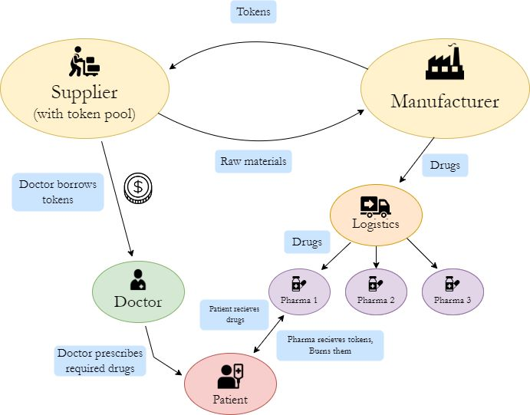

Slide 7

Thank You

